Slide 1
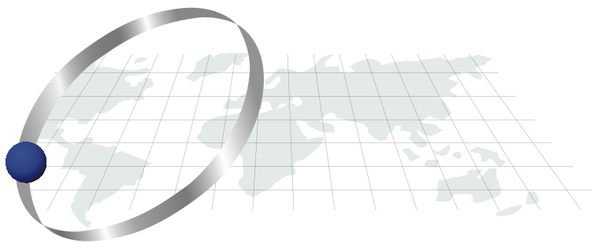
Lab exercises: installing R/ Rstudio, beginning to work with data: filtering, distributions, populations, Data Frames…
Thilanka Munasinghe
Data Analytics
ITWS-4600/ITWS-6600/MATP-4450/CSCI-4960 MGMT4962/6962/ BCBP4962
Group 1, Lab 1, February 04th, 2021

Slide 2
Admin information
Class: ITWS-4600/ 6600/MATP-4450/CSCI-4960/MGMT 4962/6962/BCBP 4960
Dates: Mondays/ Thursdays
Location: Section1:In-Person Location: TBA- Time: 8:00am -9:50am ET and WebEx for
Remote (Online) Participation. WebEx login information available on Learning
Management System (LMS)
Section2:In-Person Location: TBA - Time: 2:30pm – 4:20pm ET and WebEx for
Remote (Online) Participation. WebEx login information available on Learning
Management System (LMS)
Instructor: Thilanka Munasinghe
Instructor contact: munast@rpi.edu
Instructor Office Hours: Mon/Thur 10:30am ET – 11:30am ET or by appointment via email OR online via WebEx (Instructor online office hours login information available on LMS
Instructor office location: Room 133, Amos Eaton building
Teaching Assistant : Mukesh Mohanty
TA Office Location: Virtual (WebEx) https://rensselaer.webex.com/meet/pricem4
TA Office Hours: Tuesdays 12 pm ET - 2pm ET OR by Appointment (via WebEx)
TA Office Hours Location: Virtual via WebEx : https://rensselaer.webex.com/meet/mohanm3
TA Email Address: mohanm3@rpi.edu

Slide 3
Admin information
Class: ITWS-4600/ 6600/MATP-4450/CSCI-4960/MGMT 4962/6962/BCBP 4960
Dates: Mondays/ Thursdays
Section1:In-Person Location: TBA- Time: 8:00am -9:50am ET and WebEx for Remote (Online) Participation. WebEx login information available on Learning Management System (LMS)
Section2:In-Person Location: TBA - Time: 2:30pm – 4:20pm ET and WebEx for Remote (Online) Participation. WebEx login information available on Learning Management System (LMS)
Website & LMS = http://lms.rpi.edu and see also Course Webpage:
https://tw.rpi.edu/web/Courses/DataAnalytics/2021Spring
Schedule, lectures, syllabus, reading, assignments, etc.
Location of data and R script fragments, other documents - http://aquarius.tw.rpi.edu/html/DA/

Slide 4
Lab tasks
Installations
Exploring data and their distributions
Fitting distributions
Data Frames in R

Slide 5
Objectives for today
Get familiar with:
R (Data Frames)
Distributions
Populations
Fitting
Filtering

Slide 6
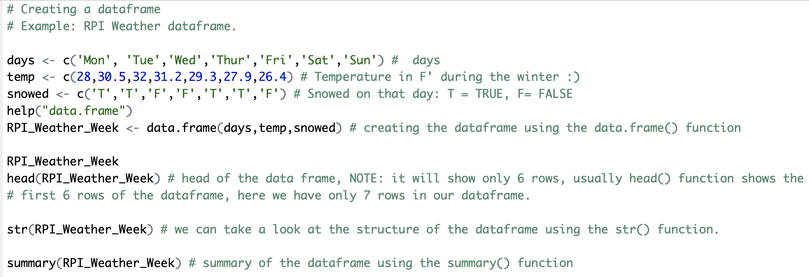
Creating Data Frames in R
Using the data.frames() in R, we can create the data frames
Read the documentation for data.frame in Rstudio,
Using the help(data.frame)

Slide 7
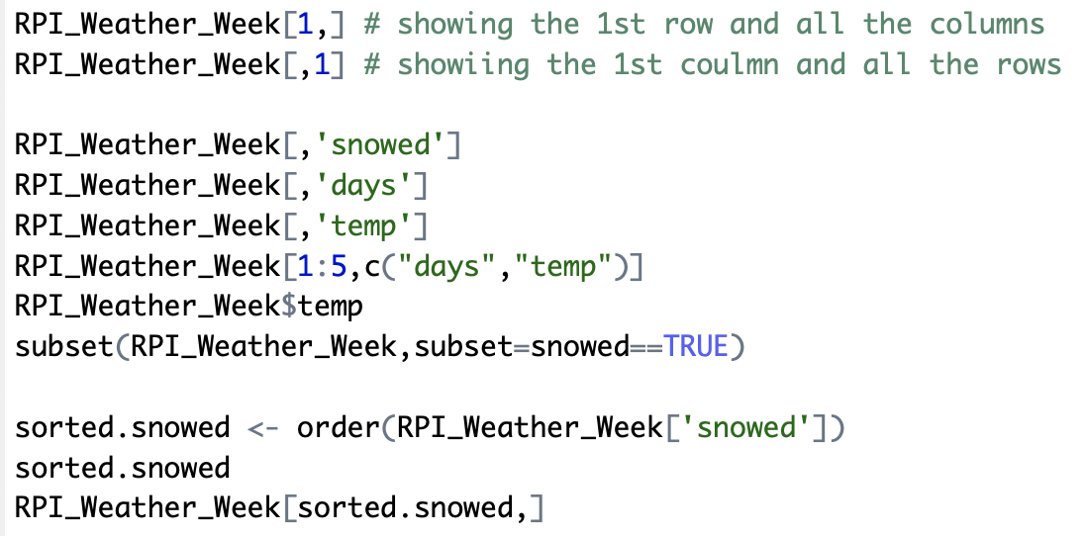
Data frames …

Slide 8
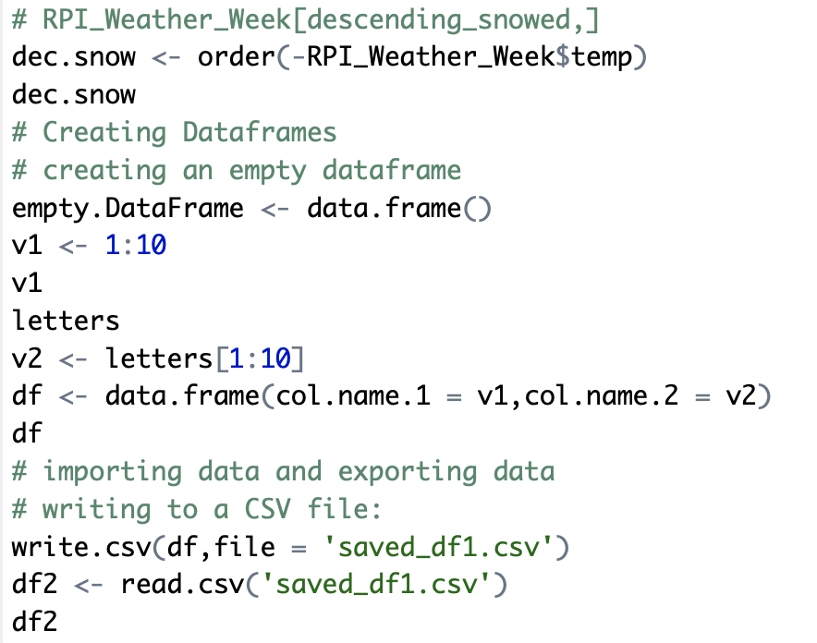

Slide 9
Table: Matlab/R/scipy-numpy
http://hyperpolyglot.org/numerical-analysis
Notes:
So let’s say you have programming experience in Matlab or Jullia and wanted to compare some of the R-functions to what you know. This is a good cross reference with Matlab, Julia etc.

Slide 10
Gnu R
http://lib.stat.cmu.edu/R/CRAN/ - load this first
http://cran.r-project.org/doc/manuals/
http://cran.r-project.org/doc/manuals/R-lang.html
R Studio – (see R-intro.html too) https://www.rstudio.com/products/rstudio/ (desktop version)
Manuals - Libraries – at the command line – library(), or select the packages tab, and check/ uncheck as needed

Slide 11
Reminder: files
http://aquarius.tw.rpi.edu/html/DA/
And some directories under this link
– please search before asking
This is where the files for assignments, lab exercises are
data and code fragments…

Slide 12
Exercises – getting data in
Rstudio
read in csv file (two ways to do this) - GPW3_GRUMP_SummaryInformation_2010.csv
Read in excel file (directly or by csv convert) - 2010EPI_data.xls (EPI2010_all countries or EPI2010_onlyEPIcountries tabs)
Plot some variables
Commonalities among them?
Also for other datasets, enter these in the R command window pannel or cmd line
> data()
> help(data)

Slide 13
Files
2010EPI_data.xls – with missing values changed to suit your application (EPI2010_all countries or EPI2010_onlyEPIcountries tabs)
See group1/lab1_data.R
Get the data read in (in e.g. use “EPI_data” for the object (in R))
> EPI_data <- read.csv(”<path>/2010EPI_data.csv")
# Note: replace default data frame name – cannot start with numbers! Munging has begun
# Note: replace <path> with either a directory path or use setwd(“<path>”)
> View(EPI_data)

Slide 14
Tips (in R)
> attach(EPI_data) # sets the ‘default’ object
> fix(EPI_data) # launches a simple data editor – test it!
> EPI # prints out values EPI_data$EPI
[1] NA NA 36.3 NA 71.4 NA NA 40.7 61.0 60.4 NA 69.8 65.7 78.1 59.1 43.9 58.1
[18] 39.6 47.3 44.0 62.5 42.0 NA 55.9 65.4 69.9 NA 44.3 63.4 NA 60.8 68.0 41.3 33.3
[35] 66.4 89.1 73.3 49.0 54.3 44.6 51.6 54.0 NA 76.8 NA NA 86.4 78.1 NA 56.3 71.6
[52] 73.2 60.5 NA 69.2 68.4 67.4 69.3 62.0 54.6 NA 70.6 63.8 43.1 74.7 65.9 NA 78.2
[69] NA NA 56.4 74.2 63.6 51.3 NA 44.4 NA 50.3 44.7 41.9 60.9 NA NA 54.0 NA
[86] NA 59.2 NA 49.9 68.7 39.5 69.1 44.6 NA 48.3 67.1 60.0 41.0 93.5 62.4 73.1 58.0
[103] 56.1 72.5 57.3 51.4 59.7 41.7 NA NA 57.0 51.1 59.6 57.9 NA 50.1 NA NA 63.7
[120] NA 68.3 67.8 72.5 NA 65.6 NA 58.8 49.2 65.9 67.3 NA 60.6 39.4 76.3 51.3 42.8
[137] NA 51.2 33.7 NA NA 80.6 51.4 65.0 NA 59.3 NA 37.6 NA 40.2 57.1 NA 66.4
[154] 81.1 68.2 NA 73.4 45.9 48.0 71.4 NA 69.3 65.7 NA 44.3 63.1 NA 41.8 73.0 63.5
[171] NA NA 48.9 NA 67.0 61.2 44.6 55.3 69.4 47.1 42.3 69.6 NA NA 51.1 32.1 69.1
[188] NA NA NA 57.3 68.2 74.5 65.0 86.0 54.4 NA 64.6 NA 40.8 36.4 62.2 51.3 NA
[205] 38.4 NA NA 54.2 60.6 60.4 NA NA 47.9 49.8 58.2 59.1 63.5 42.3 NA NA 62.9
[222] NA NA 59.0 NA NA NA 48.3 50.8 47.0 47.8
> tf <- is.na(EPI) # records True values if the value is NA
> E <- EPI[!tf] # filters out NA values, new array

Slide 15
Exercise 1: exploring the distribution
> summary(EPI) # stats
Min. 1st Qu. Median Mean 3rd Qu. Max. NA's
32.10 48.60 59.20 58.37 67.60 93.50 68
> fivenum(EPI,na.rm=TRUE)
[1] 32.1 48.6 59.2 67.6 93.5
> stem(EPI) # stem and leaf plot
> hist(EPI)
> hist(EPI, seq(30., 95., 1.0), prob=TRUE)
> lines(density(EPI,na.rm=TRUE,bw=1.)) # or try bw=“SJ”
> rug(EPI)
#Use help(<command>), e.g. > help(stem)
See group1/lab1_summary.R

Slide 16
Save your plots, name them.
Save the commands you used to generate them.

Slide 17
Exercise 1: fitting a distribution beyond histograms
Cumulative density function?
> plot(ecdf(EPI), do.points=FALSE, verticals=TRUE)
Quantile-Quantile?
> par(pty="s")
> qqnorm(EPI); qqline(EPI)
Make a Q-Q plot against the generating distribution by: x<-seq(30,95,1)
> qqplot(qt(ppoints(250), df = 5), x, xlab = "Q-Q plot for t dsn")
> qqline(x)
Notes:
Verticals. logical; if TRUE, draw vertical lines at steps.
do.points logical; if TRUE, also draw points at the (xlim restricted) knot locations. Default is true, for sample size < 1000.
https://stat.ethz.ch/R-manual/R-devel/library/stats/html/plot.stepfun.html
Sqe() : Generate regular sequences. seq is a standard generic with a default method
from:, to: the starting and (maximal) end values of the sequence. Of length 1 unless just from is supplied as an unnamed argument.
by: number: increment of the sequence.
Pplot() : Generates the sequence of probability points
dt gives the density, pt gives the distribution function, qt: gives the quantile function, and rt generates random deviates.
df: degrees of freedom (> 0, maybe non-integer). df = Inf is allowed.

Slide 18
Exercise 1: fitting a distribution
Your exercise: do the same exploration and fitting for another 2 variables in the EPI_data, i.e. primary variables (DALY, WATER_H, …)
Try fitting other distributions – i.e. as ecdf or qq-

Slide 19
Comparing distributions
> boxplot(EPI,DALY)

Slide 20
qqplot(EPI,DALY)

Slide 21
But there is more
Your exercise – intercompare: EPI, ENVHEALTH, ECOSYSTEM, DALY, AIR_H, WATER_H, AIR_EWATER_E, BIODIVERSITY ** (subject to possible filtering…)
Note 2010 and 2016 datasets….

Slide 22
Distributions
See archive “alldist.zip” or individual files in /distribution
Excel files for different distributions…
Expanded in the folder: e.g. lognorm.xls
In R:
> help(distributions)

Slide 23
Exercise 2: filtering (populations)
Conditional filtering:
> EPILand<-EPI[!Landlock]
> Eland <- EPILand[!is.na(EPILand)]
> hist(ELand)
> hist(ELand, seq(30., 95., 1.0), prob=TRUE)
Repeat exercise 1…
Also look at: No_surface_water, Desert and High_Population_Density
Your exercise: how to filter on EPI_regions or GEO_subregion?
E.g. EPI_South_Asia <- EPI[<what is this>]

Slide 24
GPW3_GRUMP – repeat…
The reading in, then exploration/summary, plots, histograms, distributions, filtering

Slide 25
water_treatment
water-treatment.csv

Slide 26
Objectives for this lab are:
Get familiar with:
Distributions
Populations
Fitting
Creating Data Frames in R.

Slide 27
Your Github Repository
Your Github Repository for this class
Please create a Github repo for the Data Analytics class Labs
Do not share the Assignment codes in your Data Analytics course repo, you share only your lab work and your individual project work/code.
Email your Github repo URL to TA
Example: https://github.com/tYourGithub/DataAnalyticsSpring2021_YOUR_NAME

Slide 28
Push your Lab code to Github
Please push your Lab1 code to Github.
TA will collect your Github repo URLs next week.
Example: https://github.com/tYourGithub/DataAnalytics2021_YOUR_NAME

